Slide 1
Tutorial:
Java environment setting and end editing tools
Professor …

Slide 2

Test-Driving a java application using javac
Checking your setup. Read the Before You Begin section of the book to confirm that you’ve set up Java properly on your computer.
Download Java at:
http://www.oracle.com/technetwork/java/javase/downloads/index.html
Writing a simple Java Program.
Welcome
Perform simple operations
Print to the console
Compiling the program
Javac command or
Executing
The java command or

Slide 3
Test-Driving a java application using javac
Test program in java
Save the program
A file name ending with the .java extension indicates that the file contains Java source code.
public class Operator {
public static void main( String args[ ] ) {
System.out.println("**********************************"); System.out.println( "Welcome to Java programming" );
int x = 30;
int y = 2;
int result = x * y + 9 / 3;
System.out.print("The result is: ");
System.out.println(result);
System.out.println("**********************************");
}
}

Slide 4
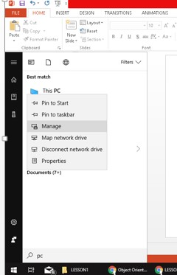
Compiling using the command prompt
Setting environmental variables

Slide 5
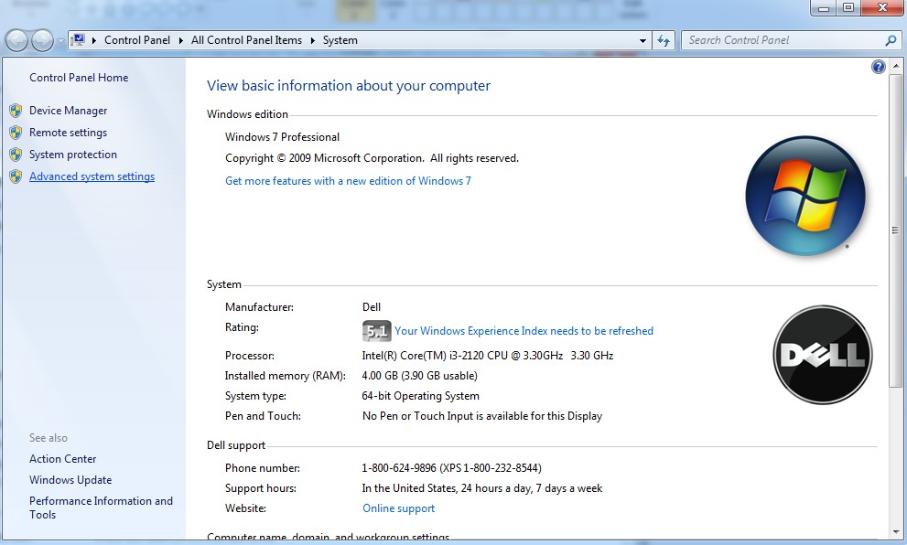
Compiling using the command prompt
Setting environmental variables

Slide 6
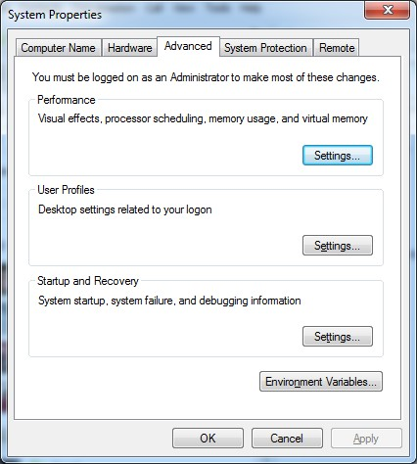
Compiling using the command prompt
Setting environmental variables

Slide 7
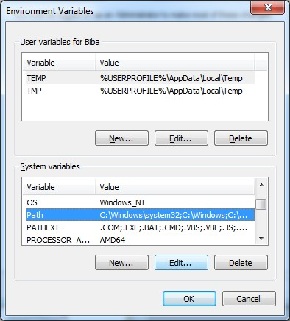
Compiling using the command prompt
Setting environmental variables

Slide 8
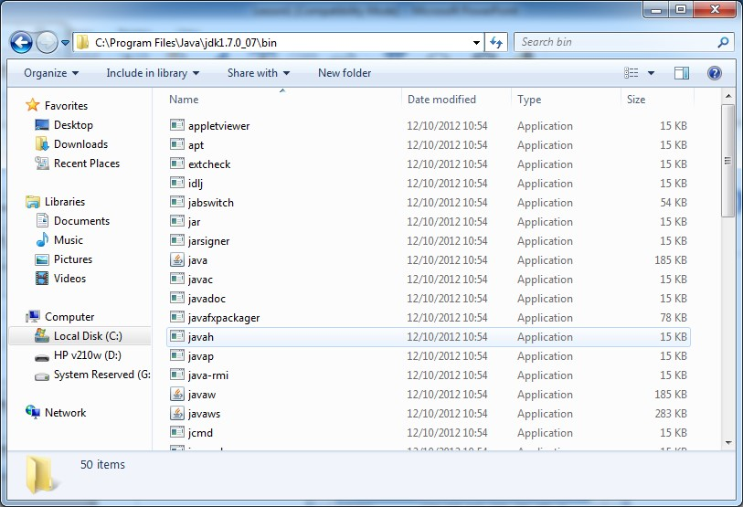
Compiling using the command prompt
Setting environmental variables
Set the environment variable in Windows. This is done only once

Slide 9
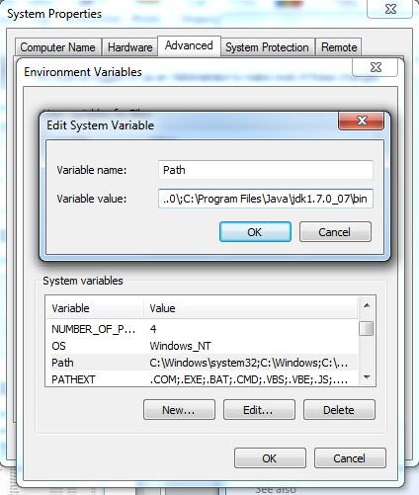
Compiling using the command prompt
Setting environmental variables
Set the environment variable in Windows. This is done only once
once.
The jdk/bin path.
Put “;” after every path.

Slide 10
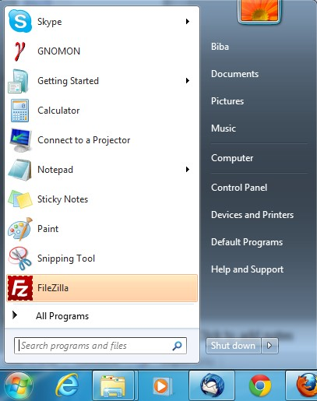
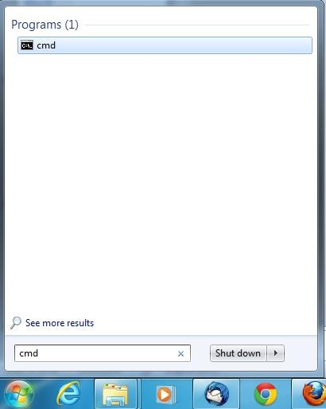
Compiling using the command prompt
Open a command prompt

Slide 11
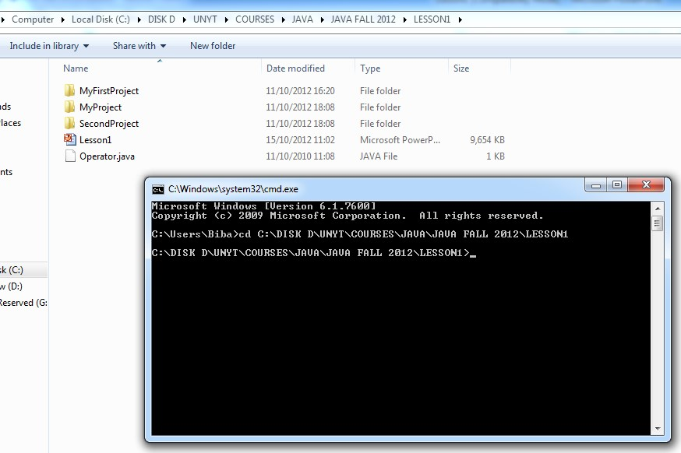
Compiling using the command prompt
Change directory to the .java file

Slide 12
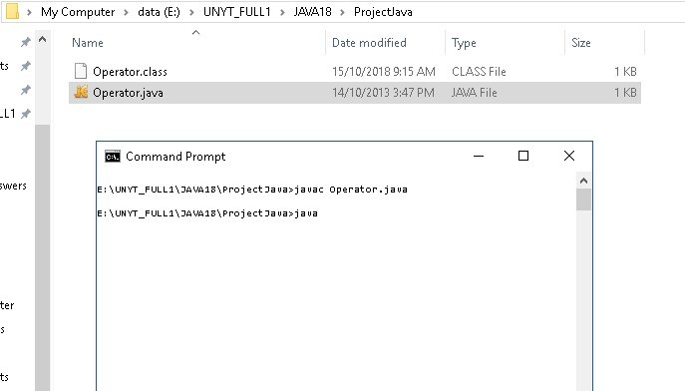
Compiling using the command prompt
Compile with javac command
.class file
generated

Slide 13
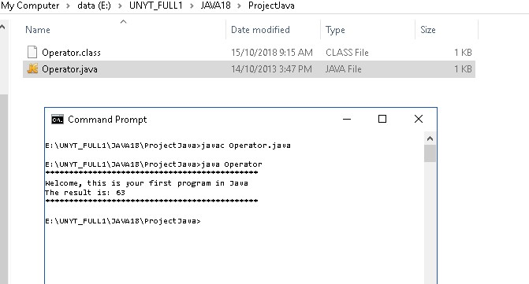
Compiling using the command prompt
Run the program with the java command

Slide 14
Eclips IDE

Slide 15

Programming and debugging in java using eclips
What is Eclips?
It is an Integrated Development Environment (IDE) where you can create, edit, compile, run, and debug your projects. It supports not only Java but also C, C++ etc. It is an open source supported by IBM and can be run on any platform with a Java Virtual Machine (JVM).
Why use Eclips?
It makes the programmer’s job easier. The features are provided in an integrated fashion which makes programming tasks easier in comparison to command utilities.
Some important features include -
Code generation.
Syntax error checking.
Formatting and indentation.
Spelling mistakes.
Ease of debugging.
Suggestions for errors fixing, etc.

Slide 16
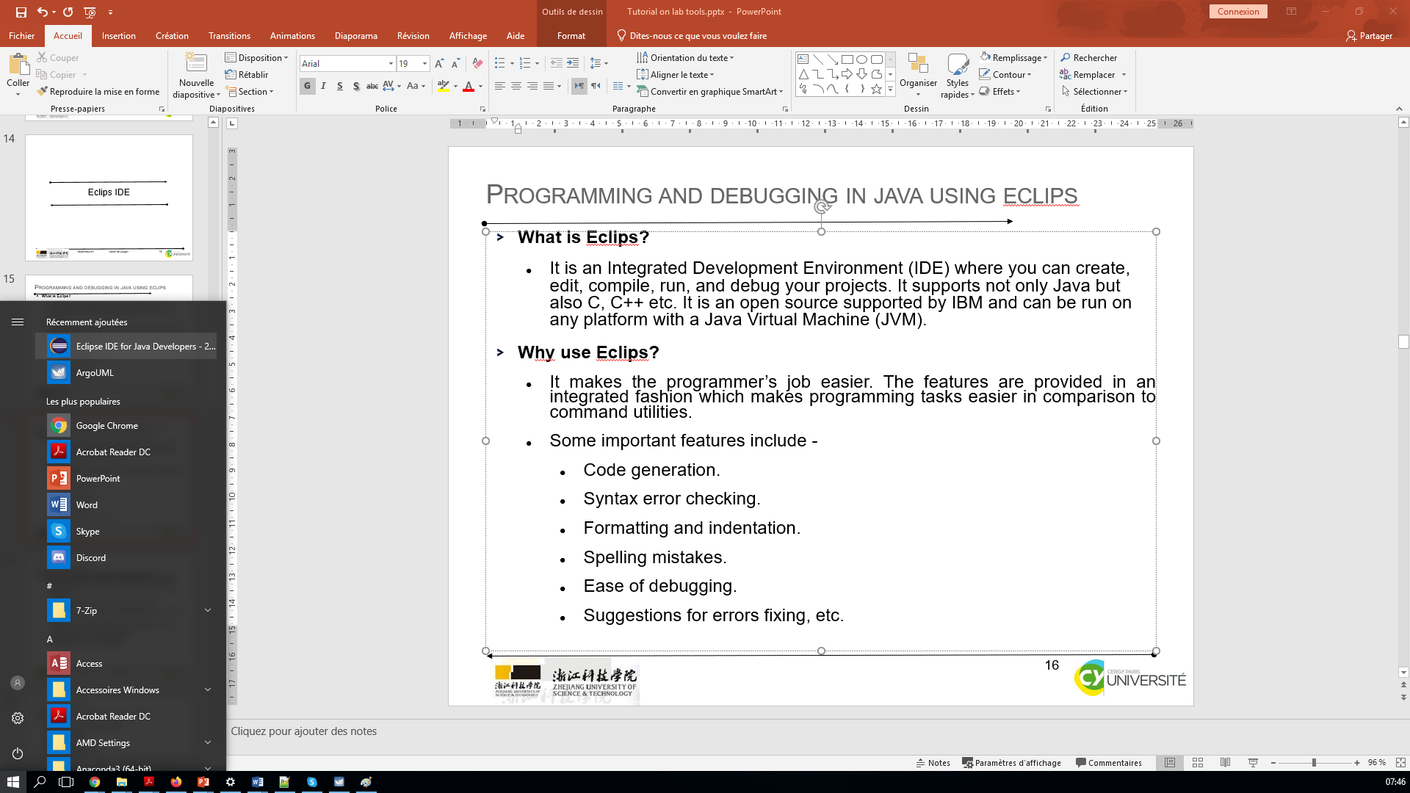
Programming and debugging in java using eclips
How to start Eclips?

Slide 17
Programming and debugging in java using eclips
How to create a project?
File>New>Java Project OR File>New>Project and choose ‘Java Project’ from the list.
You can then either choose to: ‘Create a new project in workspace’.
Enter a name for your project and click ‘Finish’ OR ‘Create project from existing source’.
Enter a name for your project, browse to the folder where the project exists, select the project, and click ‘Finish’.
Task 1: Create a new project for the purpose of this tutorial. Once you have created the project, your project will appear in the ‘Package Explorer’.

Slide 18
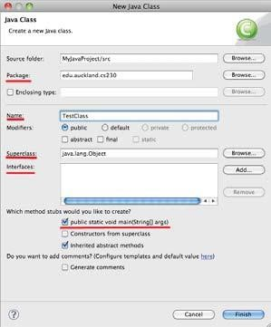
Programming and debugging in java using eclips
How to add a new class?
Right click the appropriate package,
choose New>New Class. Choose appropriate options for your class
i.e., you could have your class inherit from java.lang.Object ,
you could have your new class inherit from an existing class in your package in which case you could browse the superclass as well as inherit constructors from superclass by ticking ‘Constructors from superclass’ option,
include a main method in your class by clicking ‘public static void main (String[] args)’, add interfaces that your class needs to implement, etc. Once you have selected your options, click Finish.’.
Task 2. Create a new class in your newly created project. Give it a meaningful name, choose to inherit from java.lang.Object, and include main method in the class. Include a line of code in your class that prints your name. Note how when you are adding the code, Eclipse looks up appropriate methods and presents you the list to choose from. Also include a line of erroneous code and notice how Eclipse will find and display the errors. When you double click a displayed error, Eclipse opens the file containing the error and highlights the line of code that needs to be corrected

Slide 19
Programming and debugging in java using eclips
How to run your project?
You can run your project by clicking the Run button located the top left side of the Eclipse IDE toolbar. You may want to choose Run As ‘Java Application’..
To stop a running project, click the red stop button located above the output pane. This button is enabled only when a project is running.
Task 3. Run your project to print your name to the output console.
What are packages?
Packages are used in Java programming to organize the code.
The files are contained within the packages.
Note how the class you created is contained within the ‘default package’. You can also create your own packages by clicking
New>Package in Eclipse and then create your code files within the package.
The files contained within the package have the line ‘package <package_name>’ on their top.
You could also import other packages and files within other packages in your Java classes.Code generation.

Slide 20
Programming and debugging in java using eclips
Perspectives
Are available to show different environments within eclipse.
Some examples of these perspectives or environments are ‘Java’ (for development of java code) or ‘Debugging’.
By toggling between perspectives we can see that our workbench has different tools available designed so that a task can be carried out easily.
Eclipse is also dockable which allows for movement of tools and windows through the perspective. Occasionally this can go wrong and it is simple to just reset the perspective back to a familiar state by choosing from the menu bar -
Window -> Reset Perspective.

Slide 21
Programming and debugging in java using eclips
Debugging
Eclipse has powerful debugging tools that allow you to view the contents of the application state in memory.
It allows for developers to step through code one line at a time and stop at almost any point.
To allow for debugging a user must place breakpoints in their code to tell the debugger where to run to and wait for the developer’s next instruction.
This point of execution may hold details of state that are pertinent to fixing or understanding a problem.
Once a breakpoint has been entered and exists within the execution of code, the debugger can be started by clicking the Bug button that sits beside Run.
Typically Eclipse will ask the user to change to the debugging perspective which is a perspective that provides the developer with tools that help find bugs and understand code.
Just like the running of a normal application within Eclipse, we must either allow the execution to complete or choose to stop the application and free resources. Once either of these terminal states occurs, switch back to Java perspective to carry on developing.

Slide 22
ArgoUML tool

Slide 23
introduction to ArgoUML
Installing & using ArgoUML:
ArgoUML is a diagramming tool designed for creating and modifying UML diagrams.
Step 1: Go to http://argouml-downloads.tigris.org/argouml-0.34/
Step 2: Download ArgoUML-0.34.zip - Binary distribution (.zip format).
Step 3: Save it somewhere on your computer
Step 4: Unzip the .zip file.
Step 5: Inside the extracted directory, open argouml.jar
ArgoUML should now launch
Step 6: Use the umlexamples.zargo (found in the labs folder)
Step 7: (In ArgoUML) use File > Open Project to open the above .zargo file.

Slide 24
introduction to ArgoUML
Installing & using ArgoUML:
You should now see something like this:
Aggregation implies a relationship where the child can exist independently of the
parent. Example: Class (parent) and Student (child). Delete the Class and the Students
still exist.
Composition implies a relationship where the child cannot exist independent of the
parent. Example: House (parent) and Room (child). Rooms don't exist separate to a
House.
The above two are forms of containment (hence the parent-child relationships).
Dependency s a weaker form of relationship and in code terms indicates that a class
uses another by parameter or return type.
Dependency is a form of association.

Slide 25
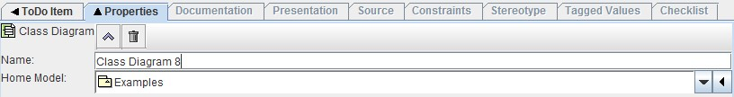
introduction to ArgoUML
Class Diagrams
Step 1: In ArgoUML go to Create > New Class Diagram
You should be presented with a blank canvas.
Optional Step 2: In the properties pane, you can rename your diagram by modifying the Name field illustrated below.:
How to use the Class Diagram Designer

Slide 26
introduction to ArgoUML
Task 1
A local pet store has contracted you to design a system to keep track of their stock, orders and customers. Before you start work on any code, they want to see what your design looks like. Draw a simple UML Class Diagram that conveys the following basic concepts.
An “Order” class to keep track of each order a customer makes. It needs to have (at minimum) the properties of “date”, “price”, “customer”, and “animals” that were sold.
An “Item” class that has a properties “type”, “price” and “quantity” for items like Toys, birdcages and fishtanks.
An “Animal” class that extends (or generalises) “Item”, to keep track of each animal in their stock. An animal needs the further properties of “breed” and “isFed”. It also needs the member (operation) of “Feed()”
A “Customer” class to keep track of each customer, with the properties “name” and “address”.
Think about the types the following variables would need to have if they were implemented as a class. The following are some type suggestions: float, boolean, String, Date.

Slide 27
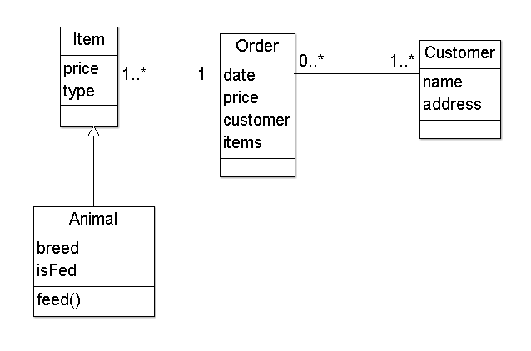
introduction to ArgoUML
Task 1 - solution:
There are multiple solutions to this task, so your answer may differ and improve on this simple diagram in different ways

